Slide 1
Event Driven Programming
Event Driven Programming for Brown Bird Department Store

Slide 2
Agendas
The purpose of this task is to develop event driven program for Blue bird Department Store
Use Of IDE
Time Scale
Event Handlers
Control Structure
If Condition, Loops
Several Events (Button Click, Text Change etc.)
Validations
Error Handling

Slide 3
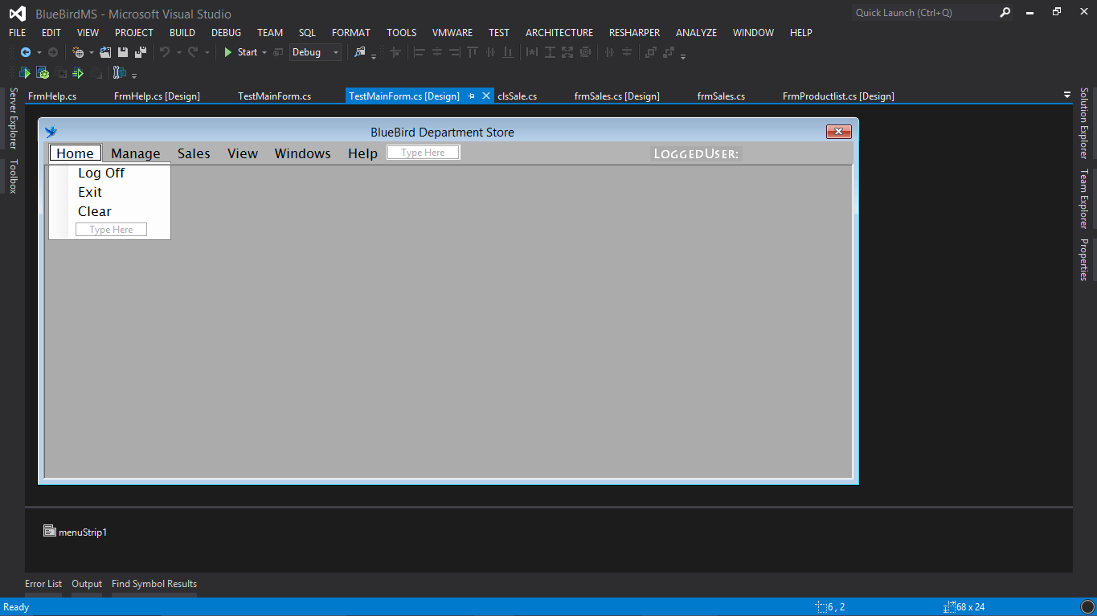
Use of IDE
Visual Studio 12 is used to develop event driven programming with c#.

Slide 4
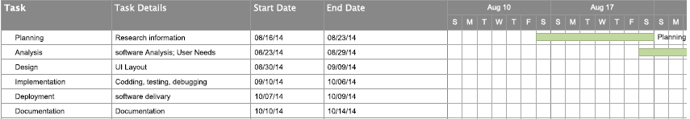
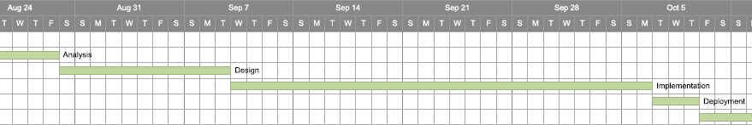
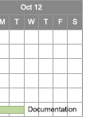
Time Scale

Slide 5
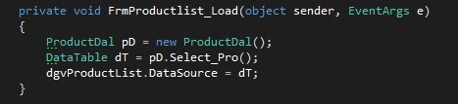
Event Handler
This represents the function that will handle an event when the event is triggered.
It is the actual code that runs when a trigger occurs.

Slide 6
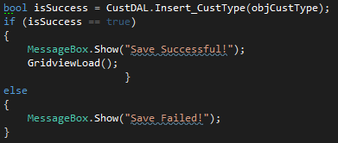
Control Structure
If-else Condition
Control Structure provides alternative for different cases.
It checks weather condition is true or not.

Slide 7
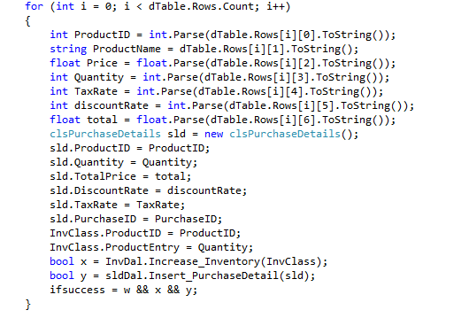
Loop
Looping is repeating block of code until the defined condition matches

Slide 8


Button Click Event
This event is triggered when user clicks on Button

Slide 9

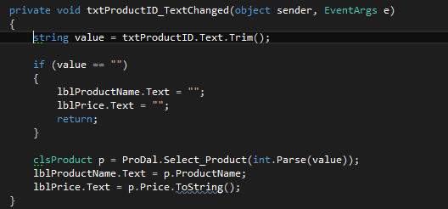
Text change event
This event is generated when text user control is changed. Text change event can be generated in textbox, level, button etc.

Slide 10
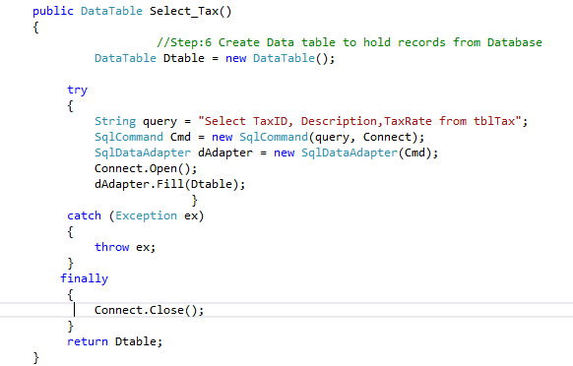
Exceptional Handling (Try-catch-finally)
It has 3 different blocks. First Try Section tries to executes the code if there is some error it inters the another section named Catch
After executing code in catch section (or) if there is no error in try section it directly inters finally section. It is great way to handle errors and exceptional cases.

Slide 11
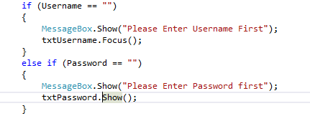
Validation
Validation is process of insuring only required and valid data is passed by user. For example in age field, validation blocks user to input alphabetical character.

Slide 12
We discussed..
Event Handler
How IDE is used to develop event driven system
How project is managed (Time Scale)
Several Events such as button click, text change etc. to develop event driven system for blue bird department store
Several control structures such as if condition, loop with example
Use and advantage of error handling (try-catch-finally) with example
Use and advantage of Validation with example

Slide 13
Questions
Thank You

